Slide 1
HYBRIS PLATFORM- USER JOURNEY
Created by Thuong Pham

Slide 2
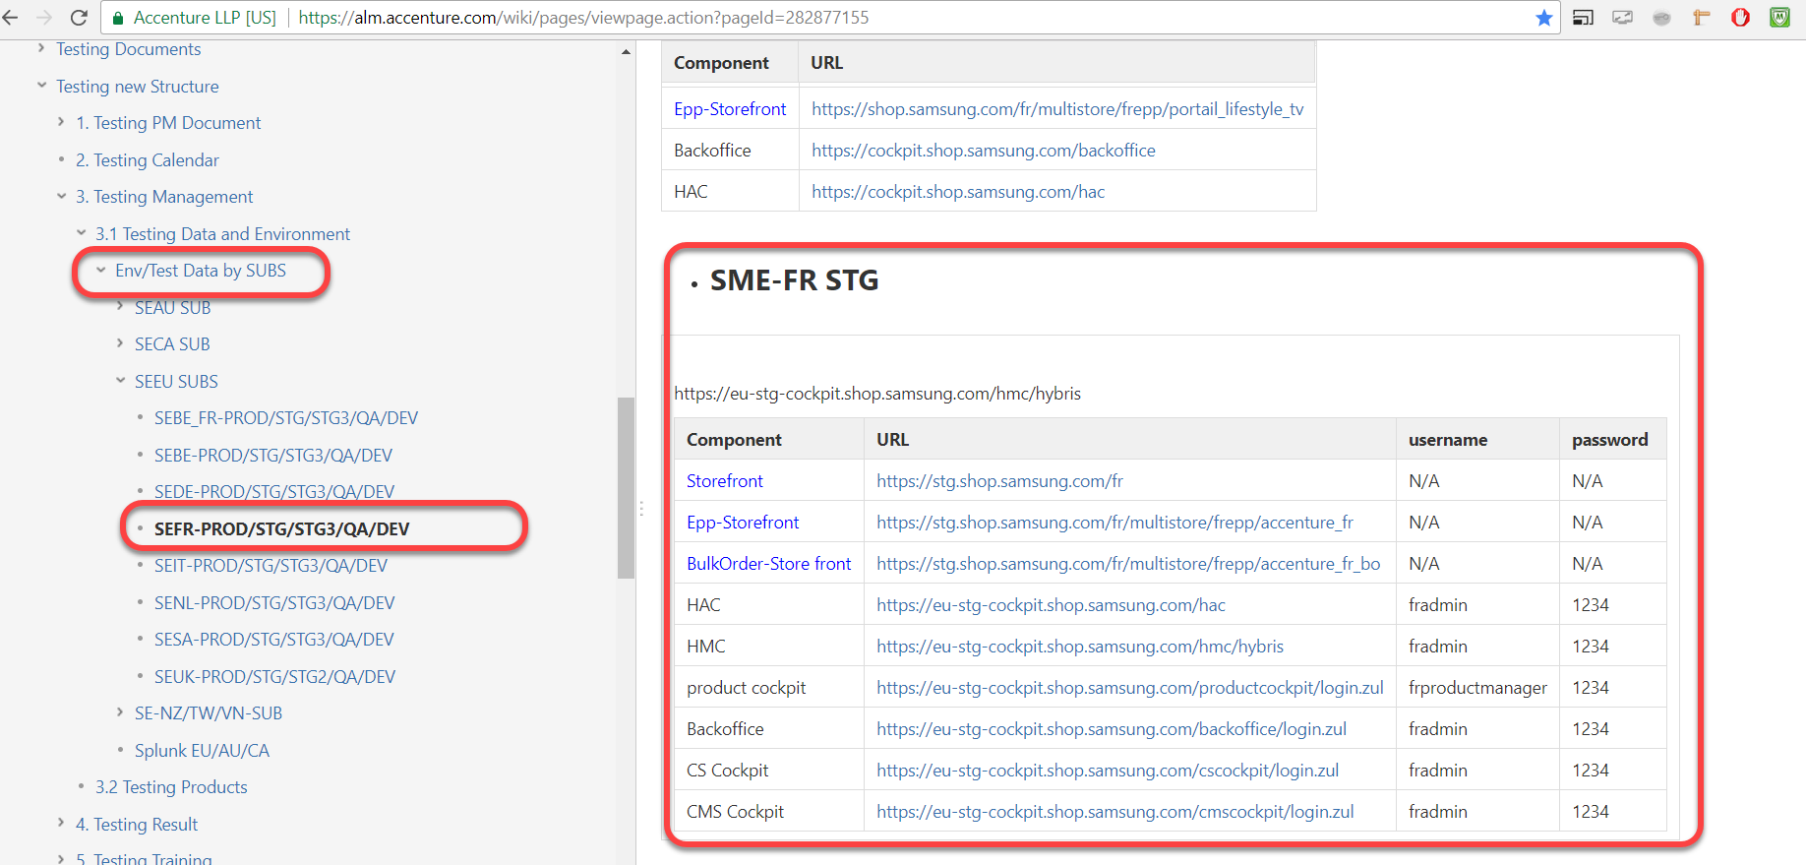
ENV/TEST DATA BY SUBS
https://alm.accenture.com/wiki/pages/viewpage.action?pageId=282640266

Slide 3
Hybris Management Console (HMC):
HMC is the administration tool of the hybris Commerce Suite. As part of the hybris Commerce Suite, it runs in web browsers. Using the hMC, you can manage business objects of the hybris Commerce Suite such as products, customer data, orders.
Hybris Administration Console (HAC):
The hybris Administration Console is an administration Web page provided by the hac extension. It provides functionality for administration, monitoring, and configuration of the hybris Commerce Suite.
Back office: The HMC is the old version of the Backoffice in Hybris.
Product cockpit: The hybris Product Cockpit enables organizations to manage and structure product information and catalogs in high-volume and collaborative environments. Product managers can visualize their input from multiple perspectives and make product management processes more efficient
PCM: Product content management => will replace Product cockpit soon
CS cockpit: The hybris Customer Service Cockpit enables you to quickly and efficiently manage the customer and orders in the call-center environment.
CS agent page: customer agent admin role
CMS cockpit: The hybris WCMS Cockpit enables you to manage data of a website. For efficient management of information on your online shop, you can use both the catalog perspective and live edit perspective. Each of them provides you with different ways of data management.
Import cockpit: import product in Flagship period

Slide 4
SITES
Estore (basestore) | EPP (enhanced purchase programe) | Bulk order | SMB/SME (small & medium business/enterprise) | Friend and Family | Outlet
https://stg2.shop.samsung.com/fi | https://stg2.shop.samsung.com/fi/multistore/fib2b/fi_epp/ | https://stg2.shop.samsung.com/nl/multistore/nlepp/accenture_nl_bo/login/multistore | https://stg2.shop.samsung.com/fi/business | https://stg2.shop.samsung.com/vn/multistore/vnepp/savinafnfepp/ | https://stg2.shop.samsung.com/fi/outlet/Products/c/1

Slide 5
LOG IN TYPE
Office Login (Email/Password) |  | Factory login (For SAVINA) (GenID/Mobile)
Domain Login …@vpbank.com, ..@techcombank.com) | Retiree Login Thuong.pham@wisewirse.com

Slide 6
-SAMSUNG ACCOUNT: SSO ACCOUNT YOUR PRIVATE EMAIL, REGISTER IN SAMSUNG ACC SITE SAVINA: MULTISTORE OF VN USE VERIFICATION CODE TYPE
1ST TIME LOG IN
SSO account | Site: account verification | Multistore site
Thuong.pham@wisewires.com => fail | thuong@vpbank.com
FROM 2ND TIME LOG IN
SSO account | Multistore site
Thuong.pham@wisewires.com

Slide 7
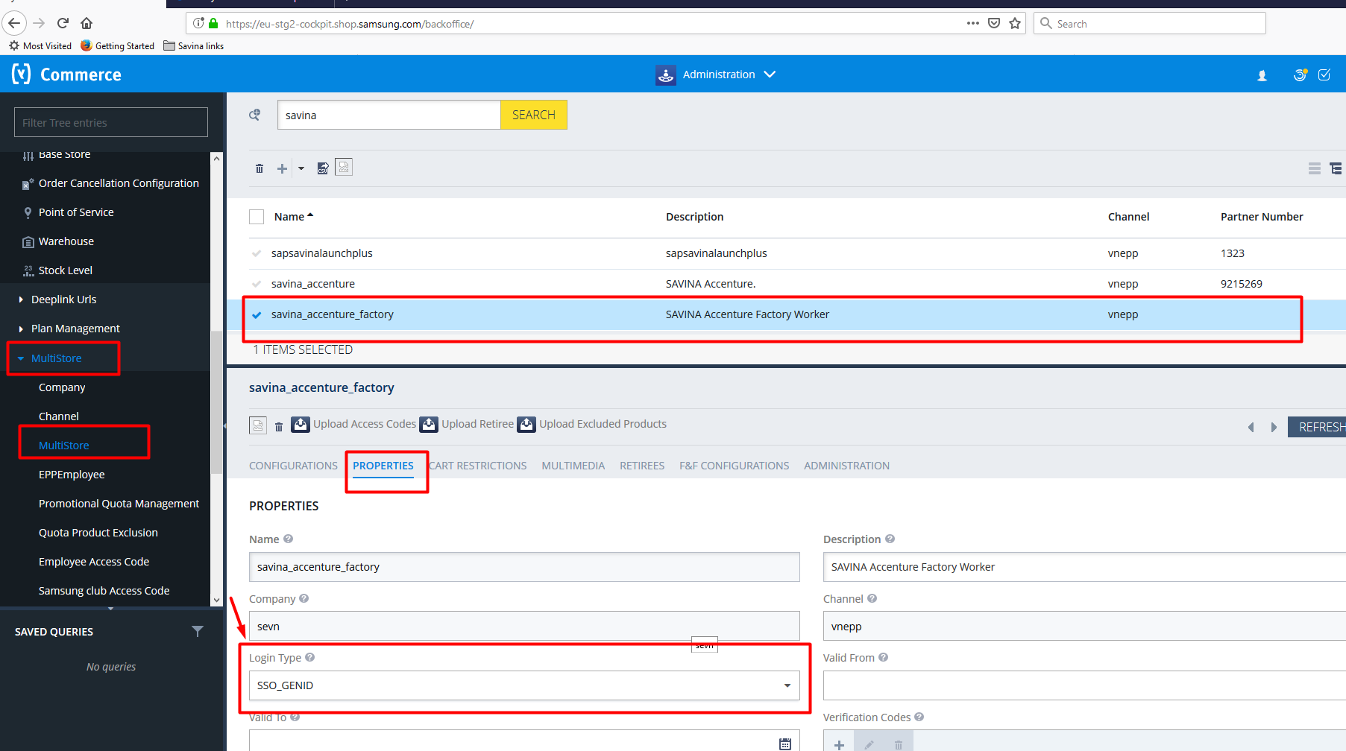

Slide 8
USER ROLE
Guest
Registered (with SSO account)
SSO register link: https://account.samsung.com/membership/intro
Guide:
\\192.168.1.68\SharedFolder\I. TRAINING\Hybris Training documents\New
File: 3 BACK OFFICE SET UP GUIDE

Slide 9
USER JOURNEY
Prepurchase
Purchase
Post purchase
All the flows that lead to Cart or Check out page
From AEM page
From Hybris page
Cart
Check out
Order confirmation page
Email/notification
My account

Slide 10
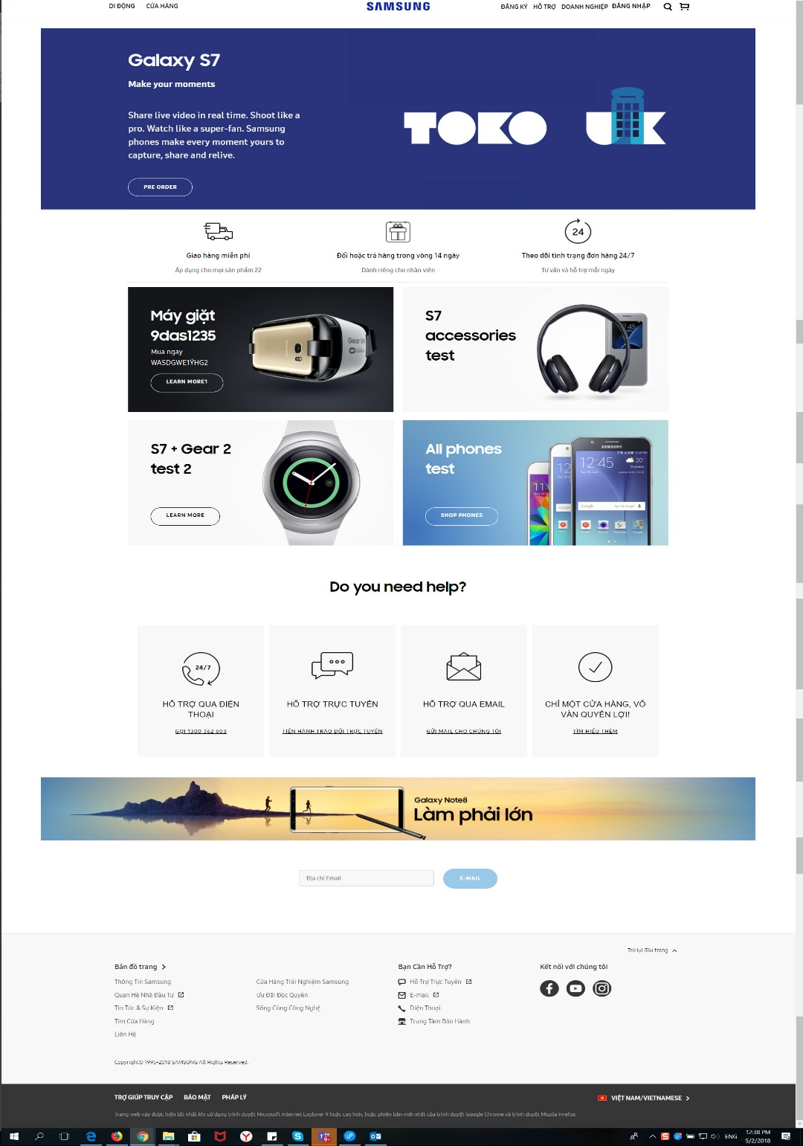
TERMS:FILE “SEUK VISUAL DESIGN TESTING MATRIX V1.0”
SHOP HOME

Slide 11
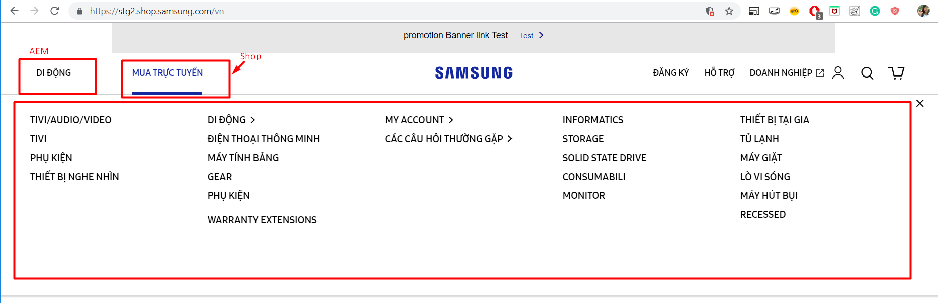

Slide 12
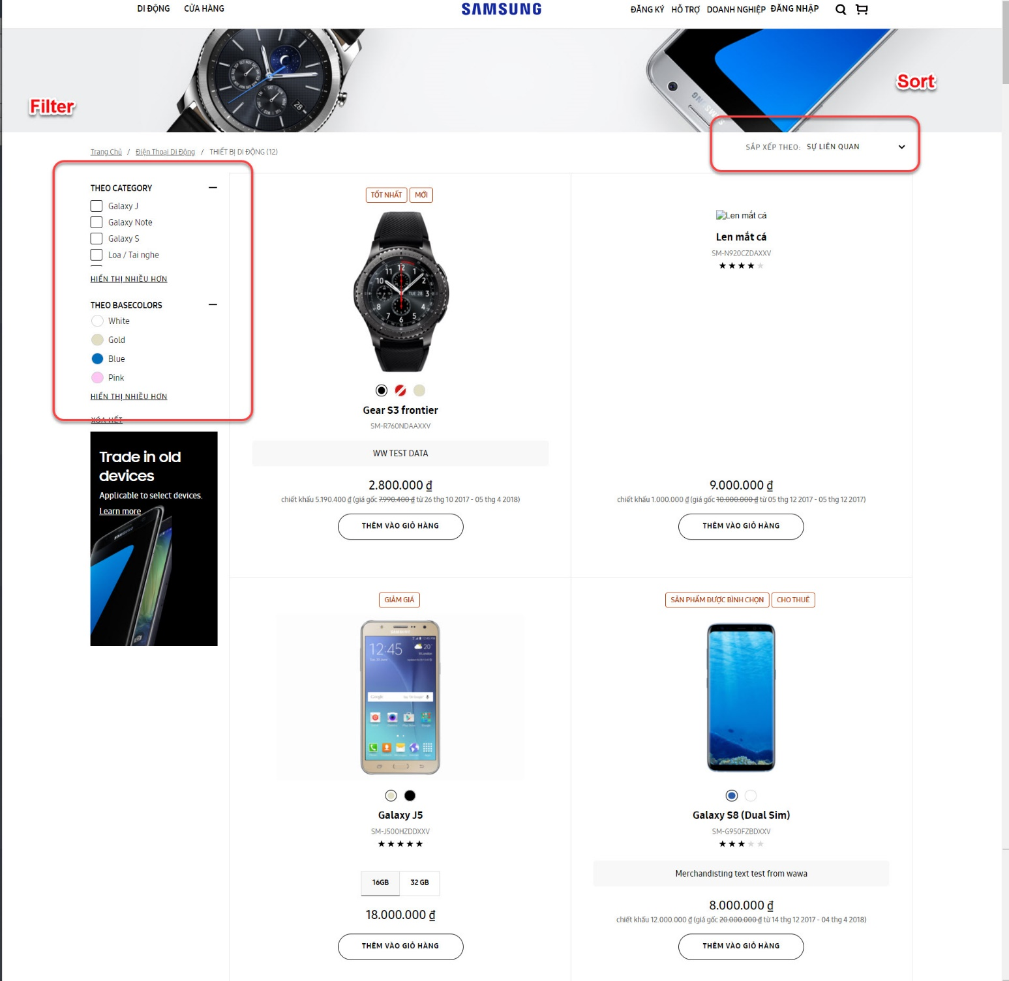
PLP

Slide 13
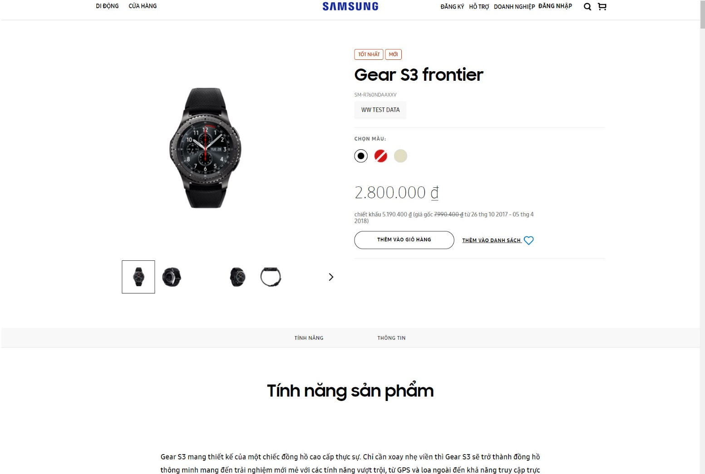
PDP

Slide 14
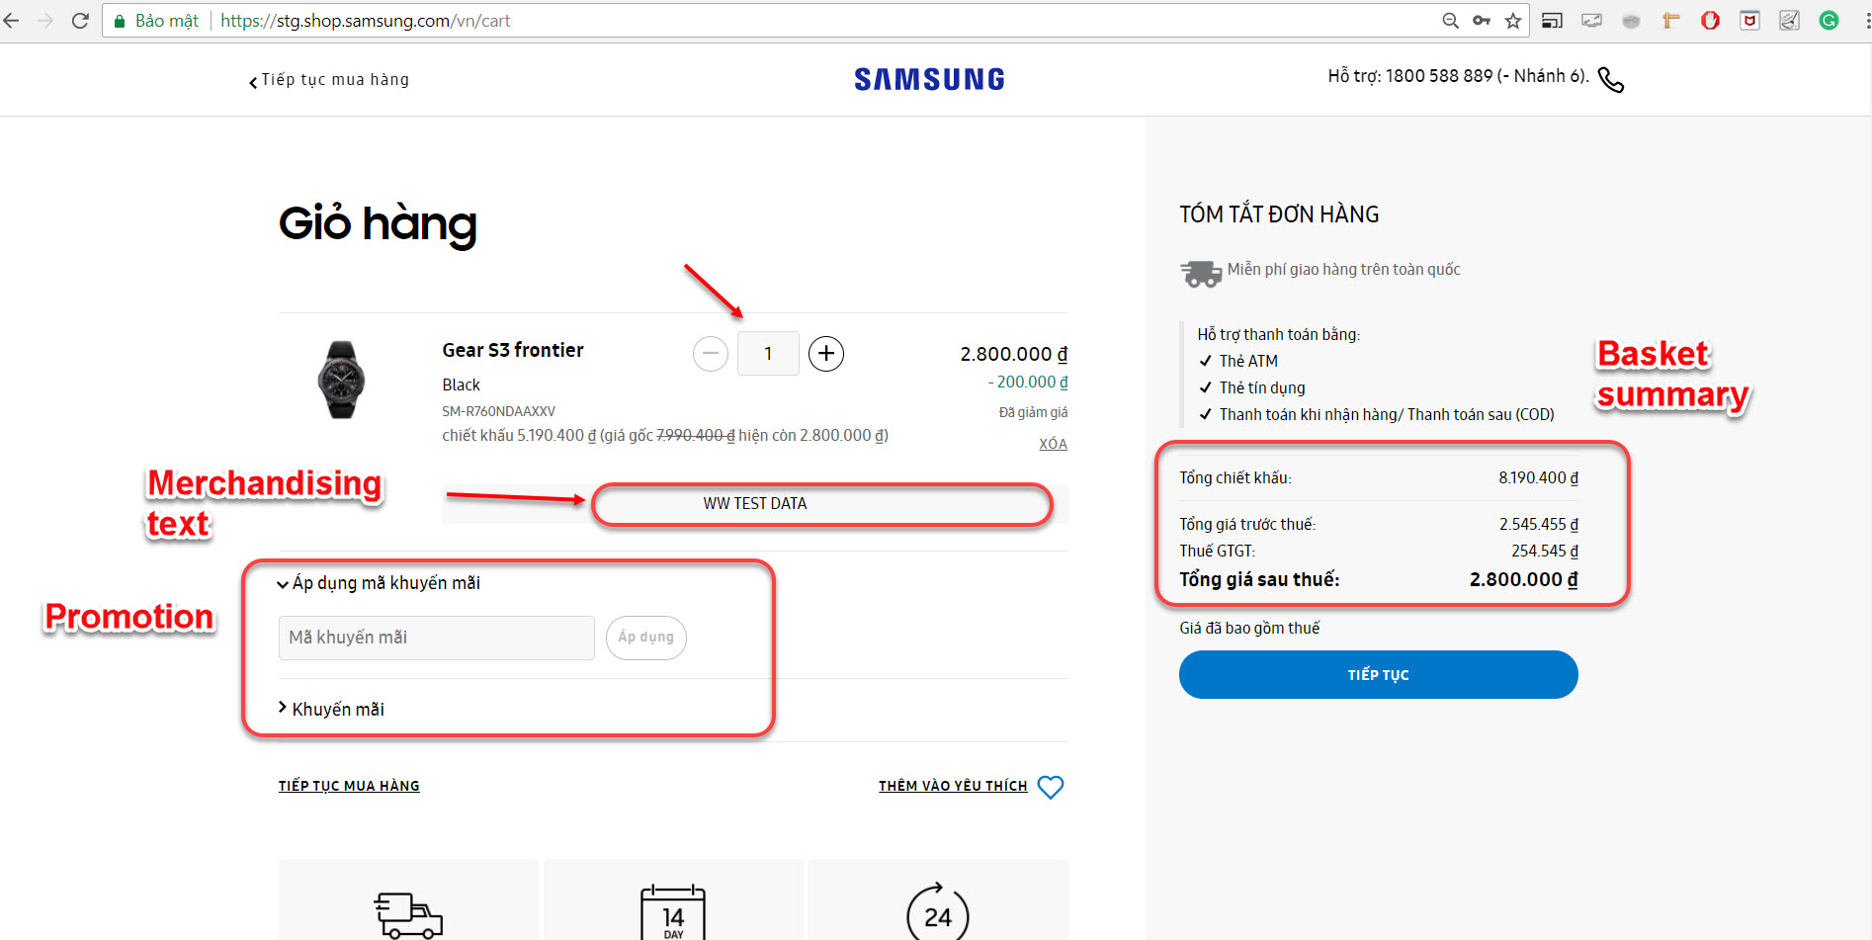
BASKET

Slide 15
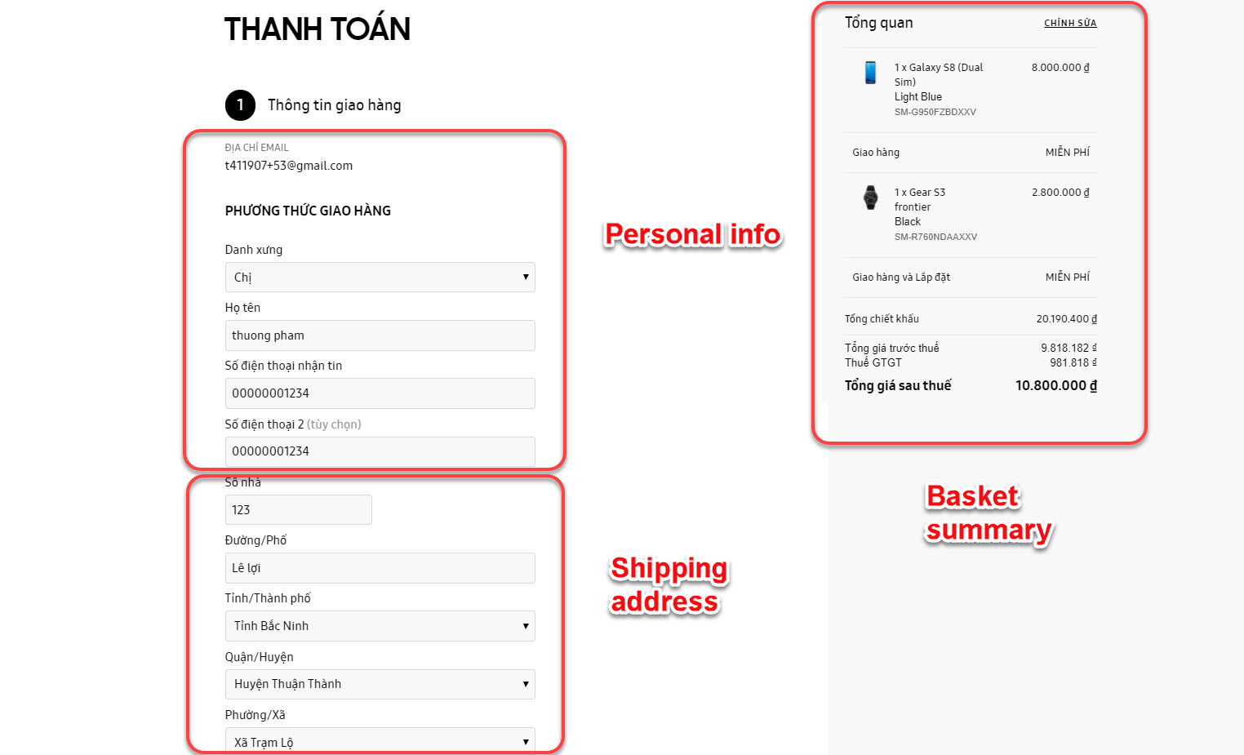
DELIVERY ADDRESS

Slide 16
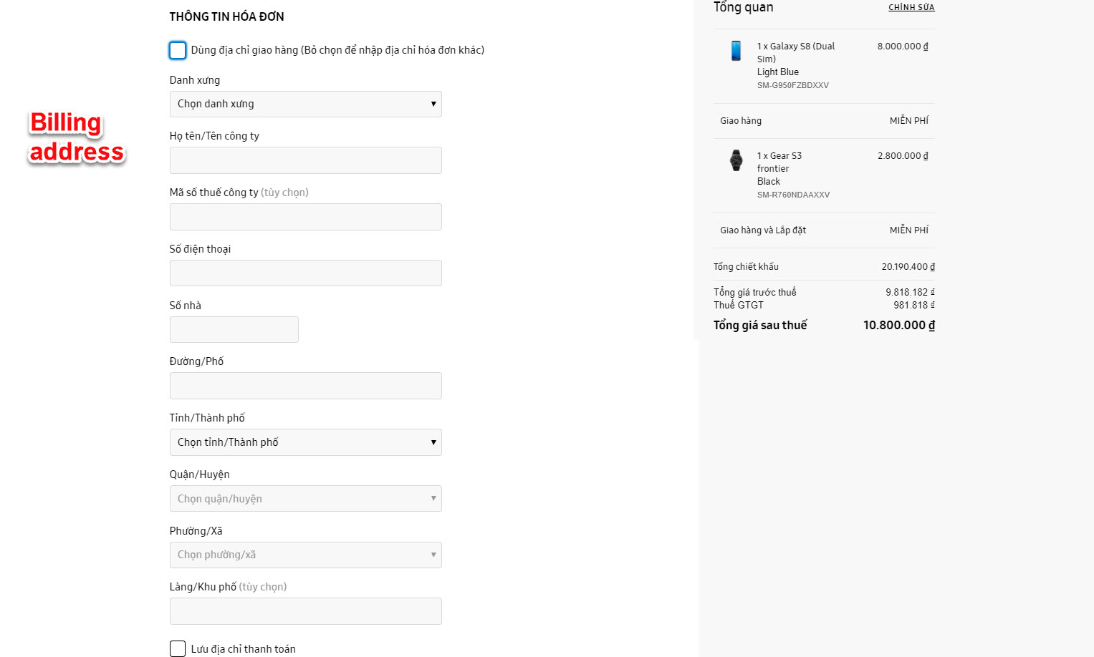
BILLING ADDRESS

Slide 17
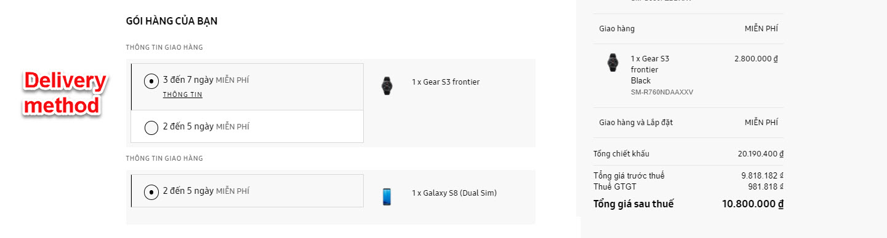
DELIVERY METHOD

Slide 18
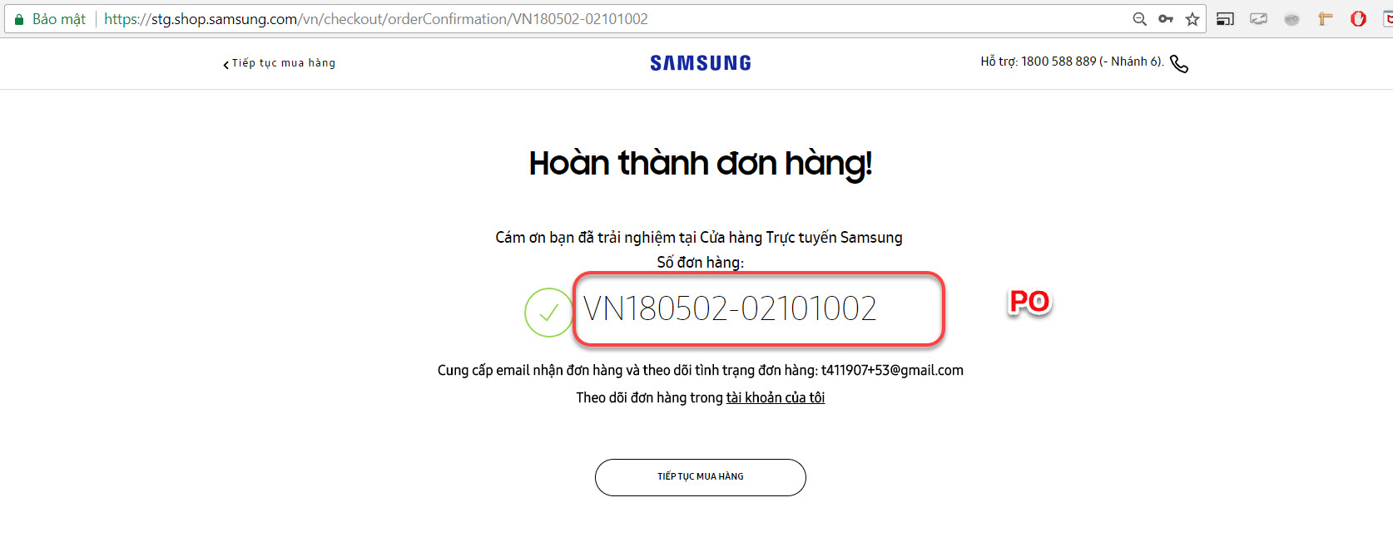
ORDER CONFIRMATION

Slide 19


